Slide 1
The Nature of God:
Impossibility of Unitarian Concepts and
Necessity of Trinitarian Nature

Slide 2
What attributes are predicated to God by both Muslims/Unitarians and Christians?
Christians
Nonmoral Attributes
Pure Actuality - Intrinsic
Divine Simplicity - Intrinsic
“Aseity” (Uncaused) – Descriptive/Intrinsic (depending on mode of speaking)
Necessity (“impossibility to not exist”) - Intrinsic
Immutability (unchanging Nature) – Intrinsic
“Impassibility” (no temporal change to His emotions) - Intrinsic
Eternality (“the duration proper to Immutable Being”) - Intrinsic
Infinity (lacking in limits of Being, “not finite”)- Intrinsic
Immateriality (“not material”) - Intrinsic
Immensity ( “not spatially measurable”) - Intrinsic
Omnipotence (Ability to make or change things in any way that it can be) – Intrinsic
“Omnipresence” (more a characteristic than an attribute) – Extension of His Infinity and Immensity
Omniscience - Intrinsic
Omnisapience (Wisdom) and Light (Spiritual Light, Radiance, Glory)- Intrinsic
Majesty (Unsurpassed Greatness, Exaltation, Glory)- Intrinsic
Beauty (“That which is perceived pleases the observer”)- Intrinsic
Life and Immortality- Intrinsic
Unity and Triunity- Intrinsic
Muslims/Unitarians
Surah 59:22-24 (Sahih International)…
“He is Allah , other than whom there is no deity,
Knower of the unseen and the witnessed.
He is the Entirely Merciful, the Especially Merciful. He is Allah , other than whom there is no deity,
the Sovereign,
the Pure,
the Perfection,
the Bestower of Faith,
the Overseer,
the Exalted in Might,
the Compeller,
the Superior.
Exalted is Allah above whatever they associate with Him. He is Allah , the Creator, the Inventor, the Fashioner; to Him belong the best names. Whatever is in the heavens and earth is exalting Him. And He is the Exalted in Might, the Wise.”
Moral Attributes
Holiness (both a nonmoral & moral attribute)- Intrinsic (nonmoral) and flowing from His Perfection (moral)
Justice/Righteousness- Intrinsic (God to Himself) and Extrinsic(God to His creatures)
Jealousy (preserving His own name and creation) – Logical outflow of Holiness + Perfection
Perfection (metaphysical and moral) - Intrinsic
Truthfulness – Intrinsic and logical outflow of Goodness
Goodness/Love - Intrinsic

Slide 3
What do we mean by “attributes”?
“Characteristics” are traits predicated to God relative to His creation (Sovereignty, Transcendence, Immanence, Omnipresence, and ineffability).
“Attributes,” on the other hand, are essential and proper to God’s nature, even without any creatures with whom He could relate. These “essential attributes” are always true of God, and they are true of God’s One Divine Essence in a way that is combinatorial.
Ex: “ God is Immutable and Eternal”
“ God is Love/Goodness”
“Therefore, God is Love/Goodness eternally and immutably.”

Slide 4
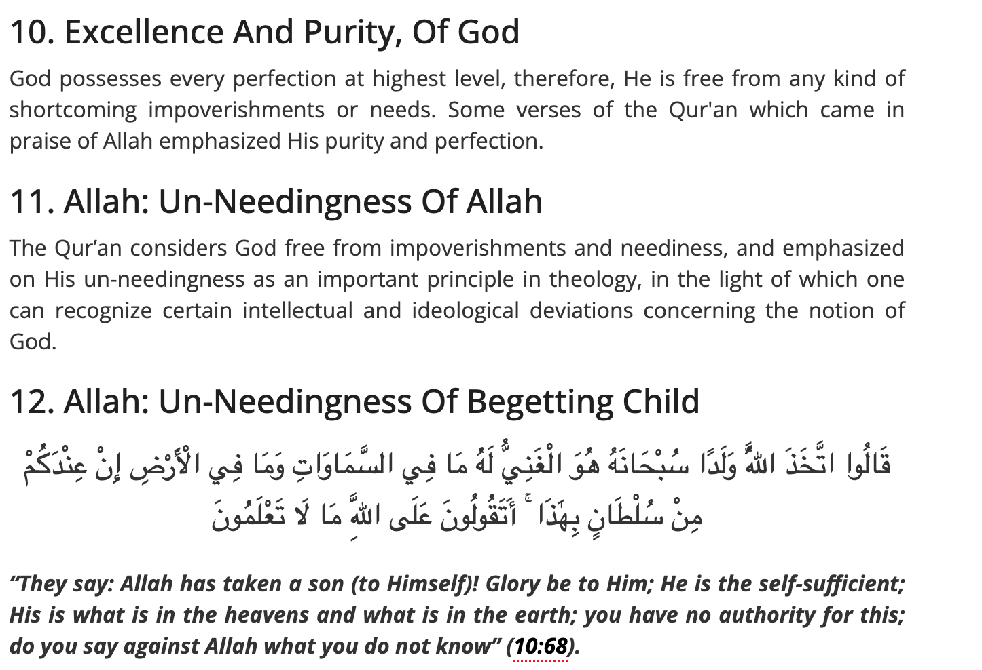
If God exists, what metaphysical and moral attributes MUST be true of God?

Slide 5
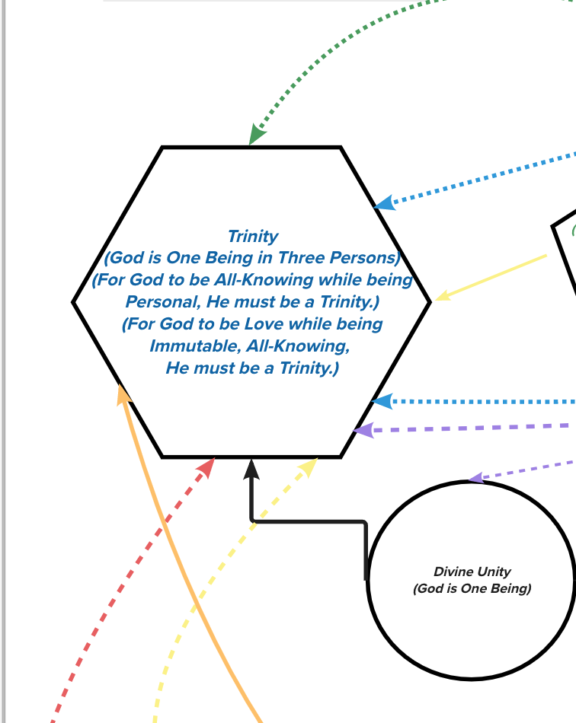
The Trinity seems to be the culmination and binding agent of many other attributes…
Pure Actuality
Eternality
Goodness/Love,
Truth
Why is that the case???
Omniscience
Perfection/Personal/Beautiful
Unity (One in Being/Divine Essence)
Metaphysical
Holiness
Immutability
Moral Holiness

Slide 6
We will walk through some basic questions and syllogisms to see why this is the case!

Slide 7
1. If God is Perfect (both Christians and Muslim Philosophers/Apologists mean to say that God is the Ultimate standard/source of Perfection for each attribute), then what do we learn about love?
P1: God is Morally + Metaphysically Perfect.
P2: Thus, He exemplifies the Objective Standard of the Perfection of Moral Goods in His Nature
(which Christians and Muslims affirm, given arguments from Objective Morality).
P3: God is Immutable/Eternal (unchanging).
P4: Thus, whatever He is essentially (at the level of His Essence), He is eternally and immutably.
P5: Therefore, whatever moral Perfections God exemplifies, He does so eternally and immutably.
P6: Love is an objective moral good.
P7: Therefore, God exemplifies the Perfect Standard of Love eternally and unchangeably.
P8: Love is “willing the good of another person,” or “willing unity with the perfection/good of another.”
P9: Therefore, God is eternally (and unchangeably) exemplifying the Perfection of Love. God is eternally
(and unchangeably) “willing the good of another person/ willing unity with the good of another.”
P10: If God is eternally only one Person, then we must assume either…
P10a: that PERFECT love is exemplified when one person wills their own good without regard for another
P10b: that PERFECT love is exemplified by “willing the good of, or unity with the good of, another person.”
However, love is then not fundamental to God’s attributes, which means He is mutable (Love became a
fundamental attribute) and/or that He is imperfect (He lacks a Moral Perfection, or He lacks an object for His love).
P11: If P10a, then God’s love is purely selfish, and so our highest form of love should be purely selfish in order to replicate His love.
P12: However, the highest form of love is not purely selfish. Furthermore, such a love would prevent God from making anything at all.
P13: If P10b, then God is not metaphysically perfect (mutable, incomplete, both). If that is the case, then He is not God.
C: Therefore, if God is Morally + Metaphysically perfect (such that His attribute is love), then He must be eternally more than 1 Person.

Slide 8
1… Simplified [For the Muslims who already agree with Christians that “God is Love”]
P1: God is Love.
P2: What God is, He is Perfectly, Maximally, and Immutably/Eternally.
P3: Therefore, God is Love immutably/eternally in the most Perfect and Maximal way.
P4: Love is “willing the good of another person/agent.”
P5: Therefore, God is immutably/eternally willing the good of another person/agent in the most Perfect and Maximal way.
P6: For God to eternally be “willing the good of another person/agent” (in a way that is the Perfect and Maximal standard of Love), there must eternally be another Person(s)/Agent(s) for Him to love.
P7: However, there can only be One Perfect Being (since another Perfect Being would have to differ from the One Perfect Being in some way to identify them as separate. But any difference would mean a difference in Perfections, which means that neither Being is truly perfect.)
P8: Therefore, there is Only One Perfect Being: God (The Divine Essence)
P9: But that which is needed for Being to be Perfect is some multiplicity of Persons/Agents (on account of Love)
Conclusion: Therefore, the One God (The One Divine Being/Essence), since He is Love, is eternally existing as a multiplicity of Persons.

Slide 9
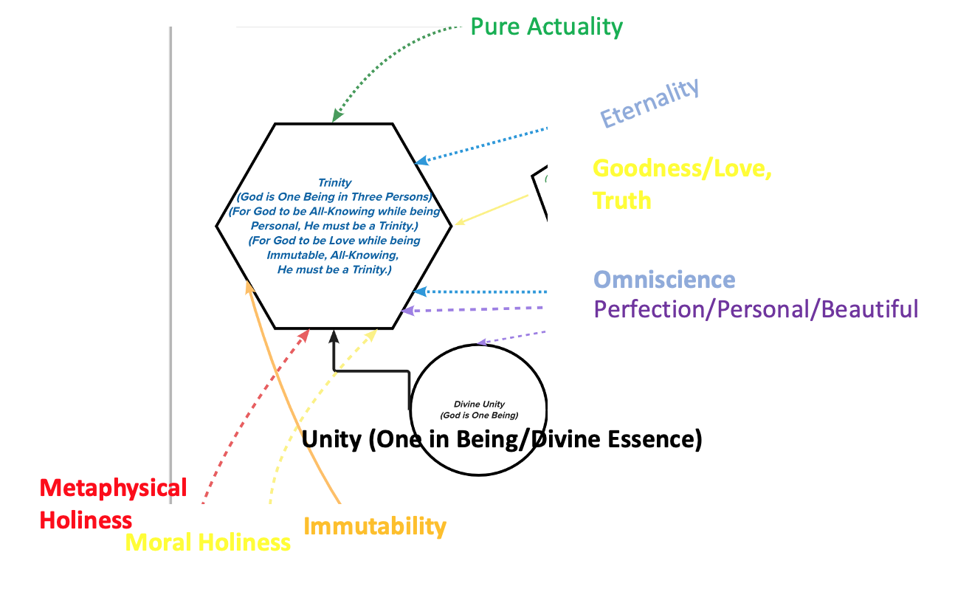

1… Simplified one more time:
Eternality
Immutability
A Plurality
Of Persons
Within
The One
Being***
Love
Perfection
*** This does not automatically prove the TRINITY. Just proves some numerical plurality, at least 2 persons.

Slide 10
2. If God is Personal (having intellect and will), Omniscient (all-knowing), and Perfect (not lacking in any goods/perfections proper to His Being), then what can be said of His Personal knowing?
P1: God is All-knowing, such that whatever could be known by God is known by God.
P2: God is Personal, in that He has/is Intellect and Will.
P3: God is Perfect, such that He is not lacking in any perfections proper to Intelligent and Willed Being.
P4: Therefore, God is Perfectly Personal in a way proper to His omniscience, and God is Perfectly All-knowing in a way proper to Him being Personal.
P5: A Way of Knowing proper to a personal being is “Social/Relational Knowledge.” “Relational Knowledge” is fully encapsulated in:
  knowledge of another person,
  knowledge of being known by another person,
  and knowledge of witnessing/testifying to the prior two acts of knowing.
P6: Therefore, God has such “Social/Relational Knowledge.”
P7: Such “Relational Knowledge,” however, requires a multiplicity of persons ( “at least” three). [Repeat P7-P9]
Conclusion: Therefore, an All-Knowing, Personal and Perfect God must exist in “at least” three Persons.

Slide 11
2. Exemplified:
The Trinity is describing these relationships within the Divine Essence, itself.
On the Matter of Knowledge:
  “God as Self-Knower”: The Father
  “God as the Object of Self-Knowledge”: The Son
  “God as the Act of Knowledge Itself”: The Holy Spirit

Slide 12
It is BECAUSE of Divine Simplicity that we can say “These Metaphysical Distinctions are fully God, in that He is His very own act of Self-Knowledge.”
But BECAUSE God’s instance of knowing Himself is Real and True(i.e., that God REALLY [not just metaphorically] does know Himself), the Self-Knower, Object of Self-Knowledge, and Act of Self-Knowledge are truly distinct as relations.
On the Matter of Self-Knowledge:
  “God as Self-Knower”: The Father
  “God as the Object of Self-Knowledge”: The Son
  “God as the Act of Self-Knowledge Itself”: The Holy Spirit

Slide 13
And Perhaps a helpful slide on DDS
Doctrine of Divine Simplicity is a doctrine which is negating composition of various forms in God:
1. God is not a body (a composition of various spatially-extended physical ends/parts)
2. God is not a form/matter composition
3. God is not an individual of a kind
4. God is not an essence/existence composition
5. God is not a substance/accidents composition
This does not entail a division in the Essence of God. In the Divinely Simple Essence
is something Triune in its Personhood (Real Relations subsisting within the One Divine Essence).
The Persons are the subsisting relations themselves.

Slide 14
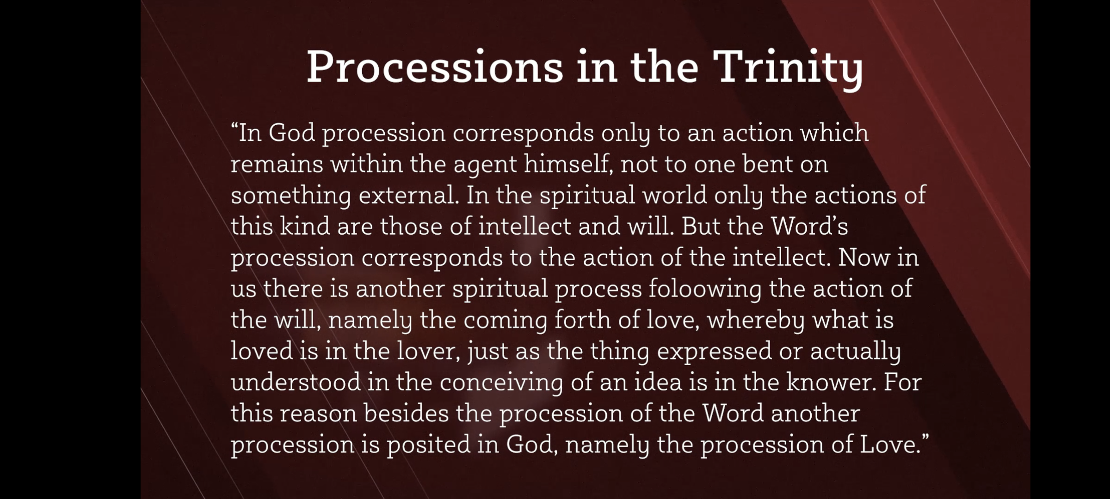
How the Trinity explains God’s love for Creation.
“The Son is known by the Father, and the Spirit is the love which consequently arises.
On this account, the Spirit is the love of the Father for the Son.
Also implied is the Spirit is the love of the Son for the Father (since the Son is Divine, He is all that
The Father is.)
4. Since the Father knows Himself in knowing the Son, His knowledge of the Son is knowledge of what
a) is distinct from Him
b) and what has the love of the Father.
5. So the Son loves as the Father loves.
6. And since the Spirit proceeds from the Father and Son, and since the Father finds His creatures in knowing
The Son, it follows that God loves His creatures through the Spirit. By the Holy Spirit, or Love proceeding… Father
and Son are loving both each other and us”
Brian Davies, “The Thought of Thomas Aquinas.”

Slide 15
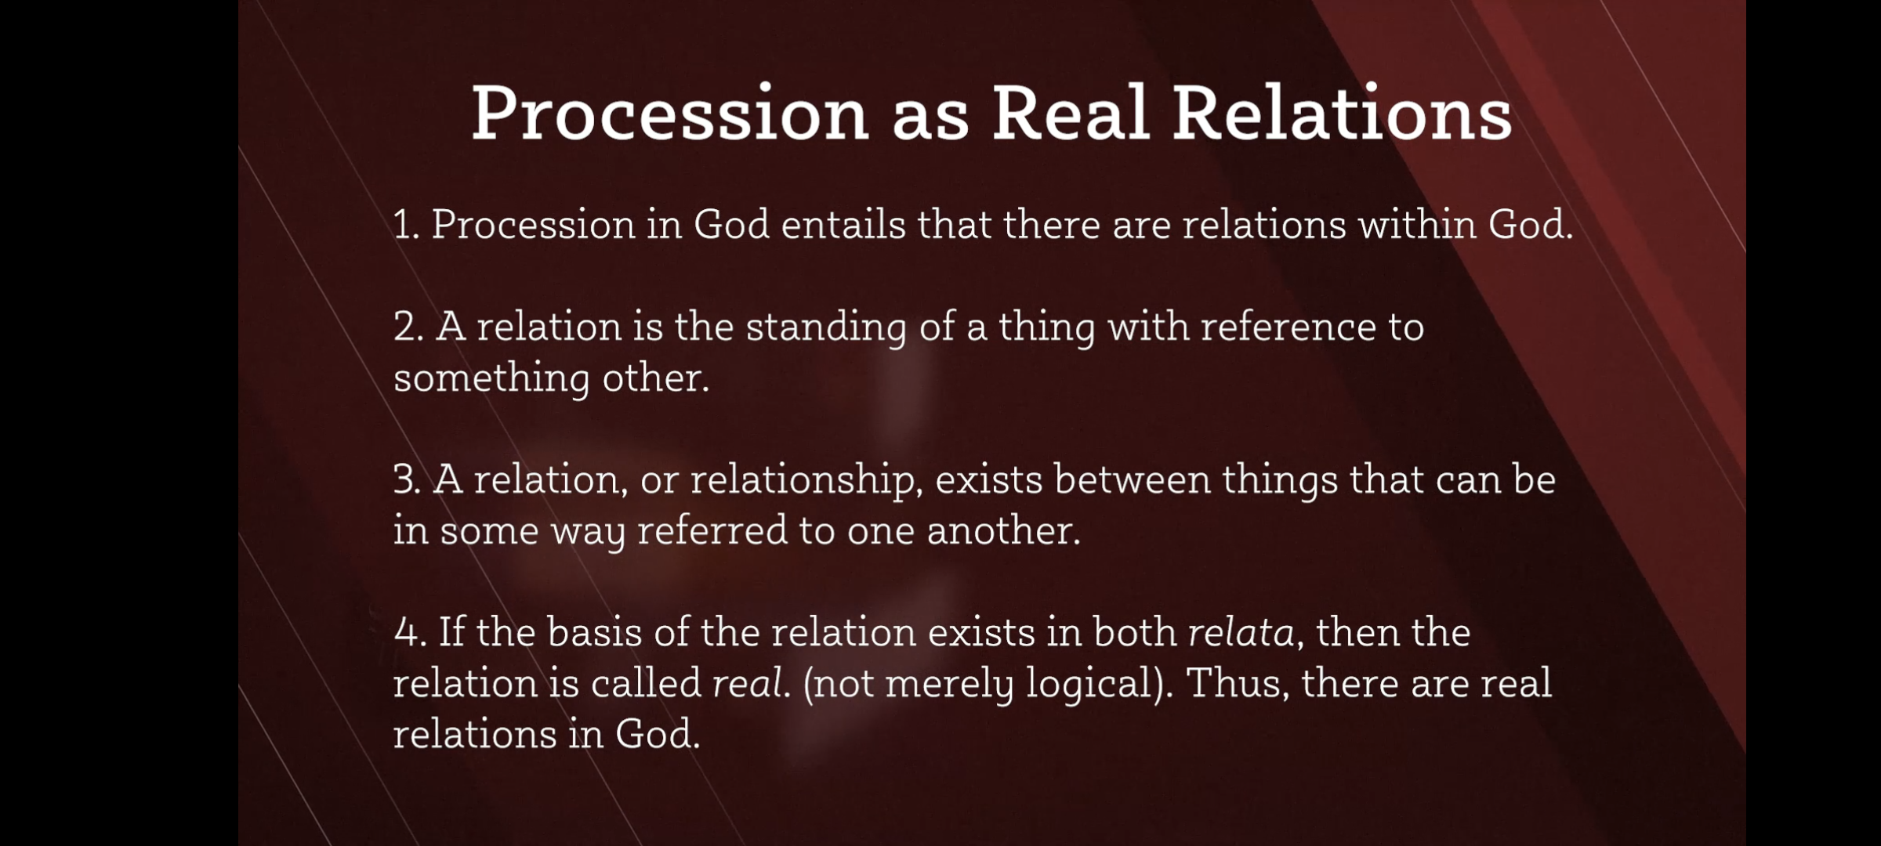
How the Trinity explains God’s choice for creating
God is goodness, itself.
God is one Being existing as three co-equal, co-eternal, co-substantial Persons.
Therefore, God’s existence as a Trinity presents a reality necessary for Goodness.
4. If Goodness is communicable by nature, then making a Universe in which rational or intelligent agents exist
would allow for God’s nature (Goodness, itself) to be communicated. This does not imply need in God since He exists as a
Perfect Being with Perfect relations in the One Divine Essence. It is simply a free choice of God to create, and this choice
can be potentially explained by the very nature of goodness as presented in God’s nature.
5. God did make a Universe which has rational and/or intelligent agents to whom goodness is communicated.
6. Therefore, goodness is communicable by nature.
7. And thus, God’s choice to create is rooted in Him being Good in a way eternally communicable (which is best explained
By the Trinity)

Slide 16
What happens if we begin to reject some of the attributes of God?

Slide 17
“God is not essentially love/loving.”

Slide 18
“God can be Maximally Great while not knowing Himself maximally”

Slide 19
“God is not essentially Personal.”

Slide 20
“God should exist in a way that is totally comprehendible and easy to understand.”

Slide 21
“God is not communicable at all. We can know nothing about God, as He is too far beyond us.”

Slide 22
“God’s fundamental nature can change” (He is not immutable)

